Slide 1

MANAGEMENT DOCTORAL STUDENT ASSOCIATION
New Student Orientation:
The Ins and Outs of MDSA
Notes:
“Welcome to the MDSA New Student Orientation. These are the slides that provide an overview”

Slide 2
NOTABLE ACRONYMS
MDSA: Management Doctoral Student Association
AOM: Academy of Management
PDW: Professional Development Workshop
MFCA: Management Faculty of Color Association
GDO: Gender & Diversity in Organizations (one of the AOM divisions)
HR: Human Resources
OB: Organizational Behavior

Slide 3

What’s MDSA?

Slide 4
Cc
  “To support all MDSA members with professional and personal development opportunities, providing us with the best opportunity to complete our programs”
Notes:
“MDSA contributes to this mission by increasing the number of minority faculty in management. And we have a conference every year before AOM to bring us all together. Specifically, the purpose of the conference is to support all MDSA members with professional and personal development opportunities, providing us with the best opportunity to complete our programs.”

Slide 5

DOCTORAL STUDENT ASSOCIATION
Management
Marketing
Information Systems
Accounting
PhD Project Staff:
Tara Perino
Cristina Pazos
Myrna Varner
Michele Marin
Finance
Notes:
“MDSA is actually one of 5 of the doctoral student associations (DSA) that are housed under the PhD Project Non-profit organization…” The PhD Project Staff support all 5 DSA’s!

Slide 6
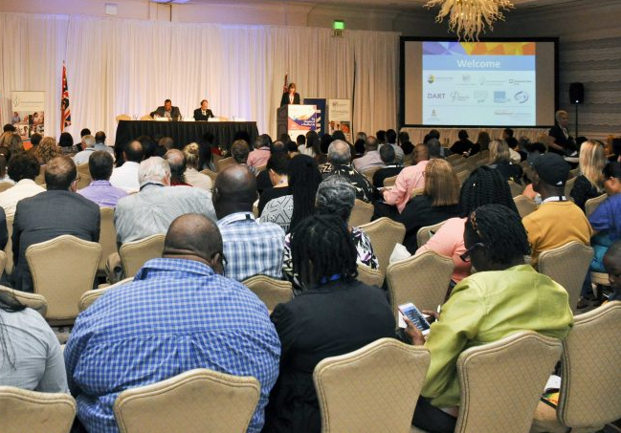


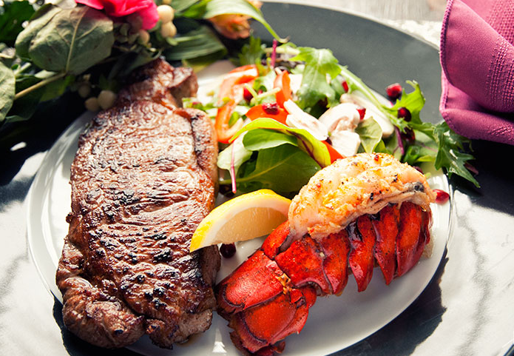
Cc
MDSA CONFERENCE
Typical Components
Sessions
Business Meeting
Networking Activities
Meals
Cohort only
Inter-cohort
(5 cohorts)
Faculty or student led
Elections
Open items
(e.g. changes to bylaws)
Discussion topics at breakfast, lunch
Social w/MFCA
“R2”
All meals provided
Formal dinner Friday
Notes:
“In general, the conference follows a similar format every year, including these main things:
-There are sessions that are both cohort and inter-cohort. All are faculty or student led. The cohort specific sessions are designed to be useful for those in specific years of their programs, so you should definitely attend your cohort specific sessions. When you see the inter-cohort ones, this means the content is applicable for everyone, so you can choose which inter-cohort session to attend.
-We will have a business meeting, where we will elect new officers and go over any official executive items
-Networking activities, like research roundtable topics or discussions may sometimes be displayed at breakfast and/or lunch. There will also be a social Thursday night with the MFCA. Lastly, there is often “research 2” networking activities after hours. Those are typically spread by word of mouth throughout the conference.
-Lastly, as you know, all meals are provided at MDSA, and there will be a formal “family reunion” dinner on Friday!
Also, every year, there is a different theme.

Slide 7
Cc
MDSA COMMITTEES
Research & Development
Networking
Cohort Liaisons
Sessions
Planning
Service
CARMA
Membership
Check out our website for more info:
https://www.managementphdproject.org/mdsacommittees
Notes:
“The success of the conference really depends on all of the 8 committees that make up MDSA. You’ll have a chance to learn more about the committees and sign up to be on one later in the conference. But this is truly a student-run conference, planned and organized largely by the sessions and planning committees.
The planning committee is made up of the executive office, which are the current president, vice president, and secretary, along with the past officers, faculty advisors, and PhD project staff.”

Slide 8

C
What’s AOM?
Notes:
“AOM is a wonderful conference and it’s always exciting for first time attendees, but there is A LOT to take in. So, to ease some of your nerves, we’ll give you a quick overview and some helpful tips.

Slide 9
C
About the AOM conference
AOM has a theme each year
Over 10,000 participants attend the Academy of Management conference
All socials and receptions are hosted by divisions or universities, and anyone can attend
AOM lasts for a total of five days
Notes:
LIE = #1 (This year’s theme is “Creating a Better World Together”)

Slide 10
C
THE AOM CONFERENCE STRUCTURE
10,000+ Attendees 2,100+ Sessions
Professional Development Workshops (PDWs):
Focused on specific topic to discuss and learn; Friday-Tuesday
Paper Sessions: Different formats (traditional, discussion); Friday-Tuesday
Symposia: Focused on specific topic, comprised of working research papers; Friday-Tuesday
Caucuses: Informal ways for those with shared interests to interact (all virtual); Friday-Tuesday
Socials/Receptions: Hosted by various committees, divisions, universities throughout AOM

Slide 11
C
GETTING INVOLVED IN AOM
Join AOM divisions
...at least one for major discipline
…at least one for interest
Make sure to subscribe to division listserves
Use your membership to obtain paper and electronic copies of AOM journal articles
Volunteer
…to review submissions for upcoming AOM meetings
…to serve on division committees that encourage doctoral student involvement (e.g., membership; newsletter)
…to serve on Academy-wide committees and task forces

Slide 12

C
HELPFUL HINTS & TIPS for AOM
Check for an email from the PhD Project in June about registering for free!
Pick up your registration materials FIRST: Make sure you are registered online
Download AOM app/ create your customized schedule:
For example: AOM 2022 Agenda
Feel free to attend all or part of a session
(leave discreetly)

Slide 13
C
HELPFUL HINTS & TIPS for AOM
Wear comfy shoes
What’s your PURPOSE?
    Network? Get citations Learn new tools? Follow a scholar? Get the lay of the land?
Attend sessions that INTEREST YOU!
Be sure to balance your time wisely!
Carve some “down time” into your schedule

Slide 14

C
Conference Buddy
Mentorship and support during the conference and beyond
MDSA Cohort Group Chat
Groupme, Whatsapp, or Slack
MDSA Membership Committee
Check for emails offering opportunities for connection
Making Connections & Seeking Support
Notes:
If you’re a new member, a member of MDSA will contacted you to introduce themselves as your conference buddy. The purpose of this mentor-mentee relationship is to build a relationship and another source of support so that they are someone you can turn to, not only this year, but in years to come. Be sure to meet up with them while you’re here and get to know them!
Also, each cohort in MDSA has a groupme that you should join to stay in contact throughout the year. Be sure to join that because it will be a life saver and a constant source of support as you continue on your year in your individual schools and programs.
Lastly, the Executive Committee and Membership Committee are here to extend support whenever you need it. Feel free to reach out to us!

Slide 15


BROAD SUGGESTIONS
Identify the salient roles in your life.
Rank order these roles by priority.
Design a daily routine that nourishes and fulfills you.
Be adaptable.
Give yourself grace.
Everyone is different, so take what resonates and leave the rest!
Notes:
This is just good life advice we wanted to share. Take what you need and leave the rest :)

Slide 16
SPECIFIC SUGGESTIONS
Manage your time:
  Identify your peak productivity hours for writing, analyses, & meetings.
  Know your ideal work duration (e.g., blocks of 3 hours).
  Set boundaries and learn how to say no.
Notes:
This is just good life advice we wanted to share. Take what you need and leave the rest :)

Slide 17
SPECIFIC SUGGESTIONS
2. Invest in your physical and mental wellbeing.
Set aside time to recharge.
Connect with family and friends.
Build a support network.
Indulge in a hobby.
Notes:
This is just good life advice we wanted to share. Take what you need and leave the rest :)

Slide 18
SPECIFIC SUGGESTIONS
3. Revisit your “why”... often
Understand what should or shouldn’t stay on your plate.
Have awareness that you will grow and change.
Give progress time.
Notes:
This is just good life advice we wanted to share. Take what you need and leave the rest :)

Slide 19
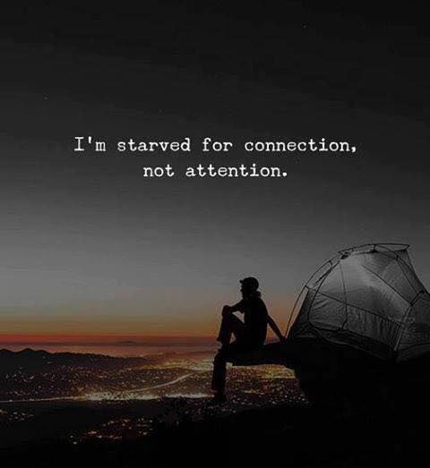
C
Thank you!
Happy conferencing ☺
mdsaexeccomm@gmail.com
Notes:
But actually though… reach out to us

